Slide 1
Regression Modeling

Slide 2
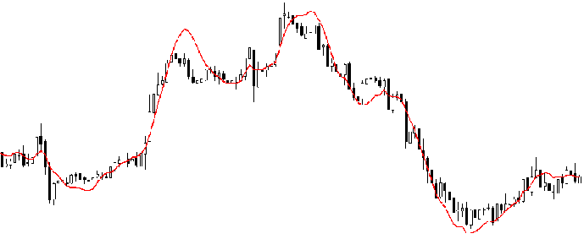
Introduction
Regression analysis is a form of predictive modelling technique which investigates the relationship between a dependent (target) and independent variable (s) (predictor). This technique is used for forecasting, time series modelling and finding the casual effect analysis between the variables. For example, relationship between rash driving and number of road accidents by a driver is best studied through regression.
Regression analysis is an important tool for modelling and analyzing data. Here, we fit a curve / line to the data points, in such a manner that the differences between the distances of data points from the curve or line is minimized. I’ll explain this in more details in coming sections.

Slide 3
Need of Regression Analysis
As mentioned above, regression analysis estimates the relationship between two or more variables. Let’s understand this with an easy example:
Let’s say, you want to estimate growth in sales of a company based on current economic conditions. You have the recent company data which indicates that the growth in sales is around two and a half times the growth in the economy. Using this insight, we can predict future sales of the company based on current & past information.
There are multiple benefits of using regression analysis. They are as follows:
It indicates the significant relationships between dependent variable and independent variable.
It indicates the strength of impact of multiple independent variables on a dependent variable.
Regression analysis also allows us to compare the effects of variables measured on different scales, such as the effect of price changes and the number of promotional activities. These benefits help market researchers / data analysts / data scientists to eliminate and evaluate the best set of variables to be used for building predictive models.

Slide 4
Types of Regression
Regression Analysis
Linear Regression
Multiple Regression
Logistic Regression

Slide 5
Types of Regression
Simple linear regression
One dependent variable (interval or ratio)
One independent variable (interval or ratio or dichotomous)
Multiple linear regression
One dependent variable (interval or ratio)
Two or more independent variables (interval or ratio or dichotomous)
Logistic regression
One dependent variable (binary)
Two or more independent variable(s) (interval or ratio or dichotomous)
Ordinal regression
One dependent variable (ordinal)
One or more independent variable(s) (nominal or dichotomous)
Multinomial regression
One dependent variable (nominal)
One or more independent variable(s) (interval or ratio or dichotomous)
Discriminant analysis
One dependent variable (nominal)
One or more independent variable(s) (interval or ratio)

Slide 6
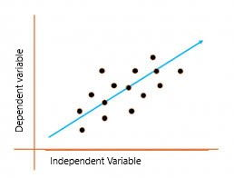
Linear Regression
Linear regression is a quiet and the simplest statistical regression method used for predictive analysis in machine learning. Linear regression shows the linear relationship between the independent(predictor) variable i.e. X-axis and the dependent(output) variable i.e. Y-axis, called linear regression. If there is a single input variable X(dependent variable), such linear regression is called simple linear regression.
The above graph presents the linear relationship between the output(y) variable and predictor(X) variables. The blue line is referred to as the best fit straight line. Based on the given data points, we attempt to plot a line that fits the points the best.

Slide 7
Linear Regression
Calculate best-fit line linear regression uses a traditional slope-intercept form which is given below,
Y_{i} = β₀ + β₁X_{i}
Where Y_{i} = Dependent variable to the given value of Independent variable.
β₀ = constant/Intercept the predicted value of y when x is 0.
β₁ = Slope or regression coefficient (how much we except y to change as x increase).
X_{i} = Independent variable (The variable we expect influencing the dependent variable y).
This algorithm explains the linear relationship between the dependent(output) variable y and the independent(predictor) variable X using a straight line.
But how the linear regression finds out which is the best fit line?
The goal of the linear regression algorithm is to get the best values for B₀ and B₁ to find the best fit line. The best fit line is a line that has the least error which means the error between predicted values and actual values should be minimum.

Slide 8
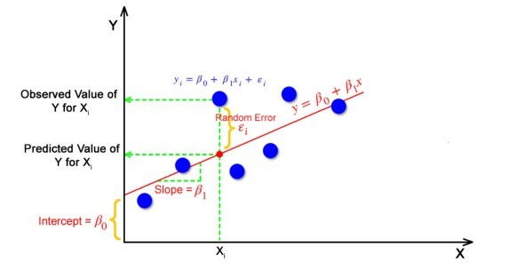
You can use the simple linear regression when you want to know:
How strong the relationship between two variables.
The value of dependent variable at a certain value of independent variable.

Slide 9
Assumptions Linear Regression
Homogeneity of Variance: The size of the error in our prediction doesn’t change significantly across the value of independent variable.
Independence of observations: the observations in the dataset were collected using statistically valid sampling methods, and there is no hidden relationships among variables.
Normality: The data follows a normal distribution.
Simple LR makes one additional assumption.
The relationship between the independent and dependent variable is linear. The line of the best fit through the data point is a straight line rather than a curve.

Slide 10
Calculate R²
To check the goodness of fit, R² is calculated.
R-Squarred value is the statistical measure of how close the data are to the fitted regression line.
It determines that x and y are correlated or not. Large value shows the better model.
For this calculate:
Distance of actual-mean
Distance of predicted-mean
This is R²⁼

Slide 11
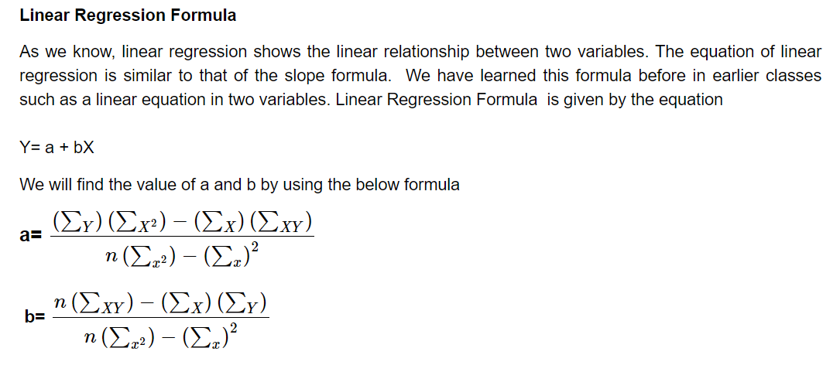
Linear Regression Solved Numerical

Slide 12
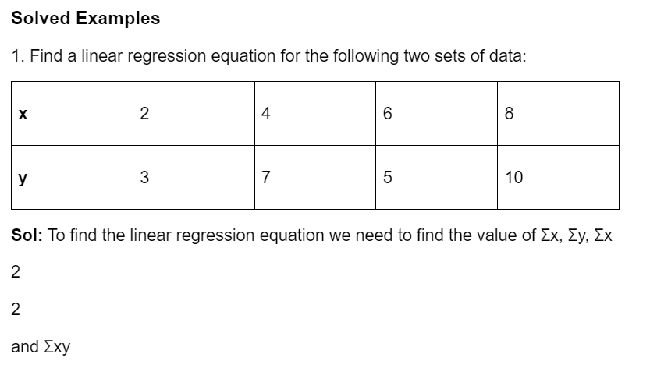
Linear Regression Solved Numerical

Slide 13
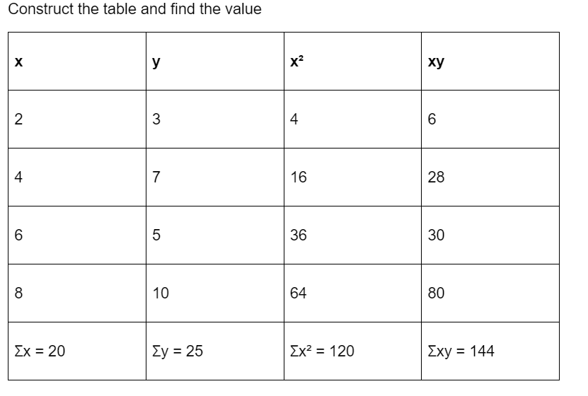
Linear Regression Solved Numerical

Slide 14
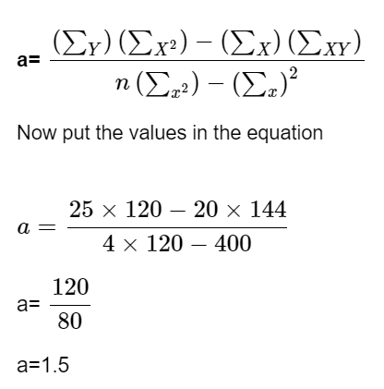
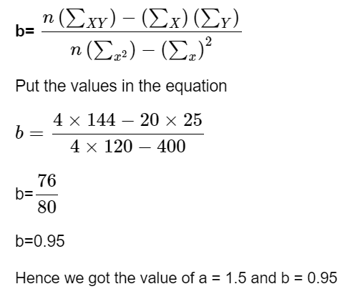
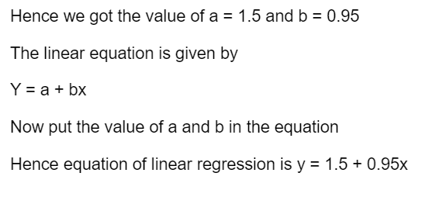
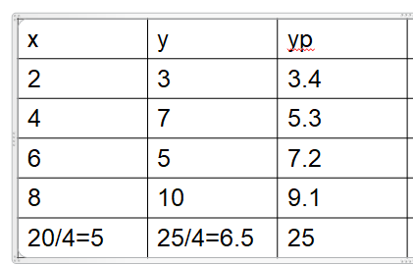
Linear Regression Solved Numerical

Slide 15
Multiple Linear Regression
Multiple linear regression (MLR), also known simply as multiple regression, is a statistical technique that uses several explanatory variables to predict the outcome of a response variable. The goal of multiple linear regression is to model the linear relationship between the explanatory (independent) variables and response (dependent) variables.
​
yi​=β₀​+β_{1​}x_{i1}​+β_{2​}x_{i2}​+...+β_{p​}x_{ip}​+ϵ
where, for i=n observations:
yi​=dependent variable
xi​=explanatory variables
β0​=y intercept (constant term)
βp​=slope coefficients for each explanatory variable
ϵ=the model’s error term (also known as the residuals)
As the number of independent variable increases to 2 our graph become 3D. The added 3rd dimension represents other independent variable.​
Independent Variable

Slide 16
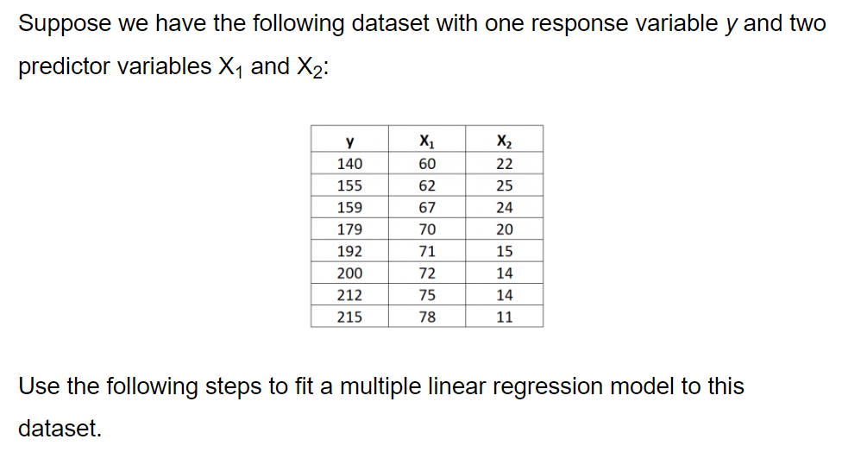
Multiple Linear Regression Numerical

Slide 17
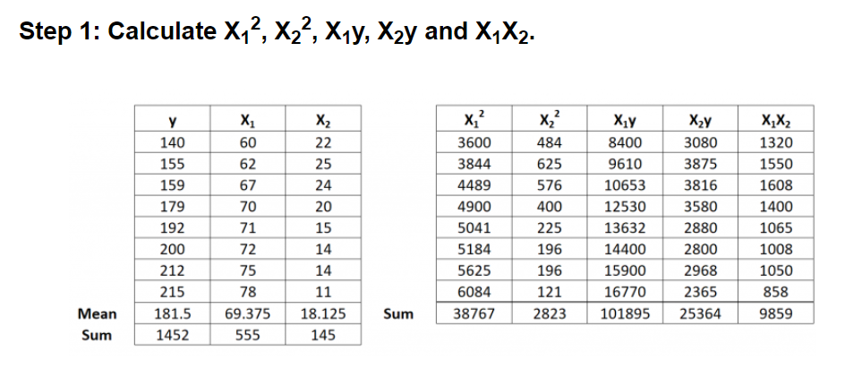
Multiple Linear Regression Numerical

Slide 18
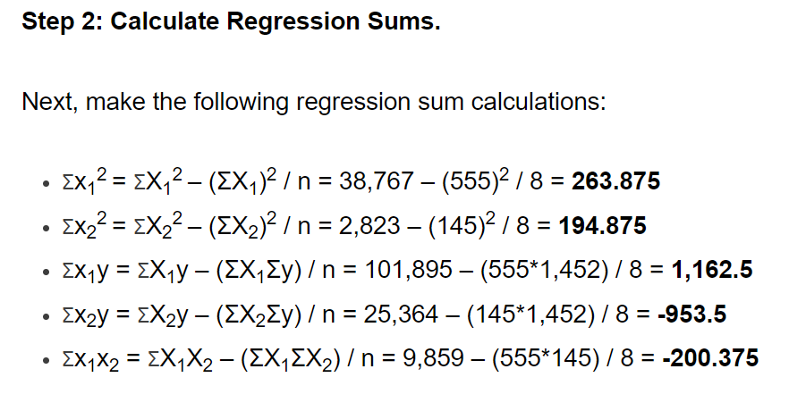
Multiple Linear Regression Numerical

Slide 19
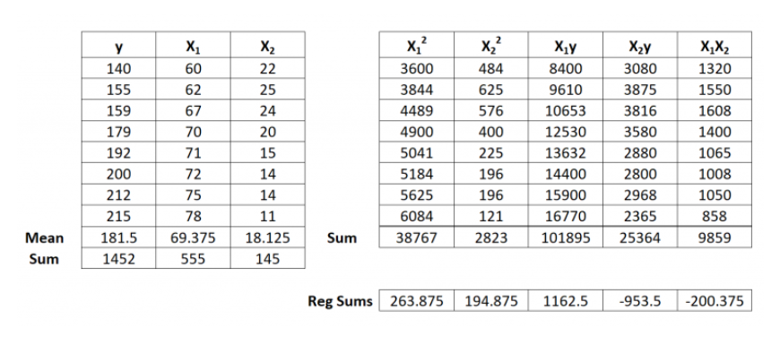
Multiple Linear Regression Numerical

Slide 20
Multiple Linear Regression Numerical

Slide 21
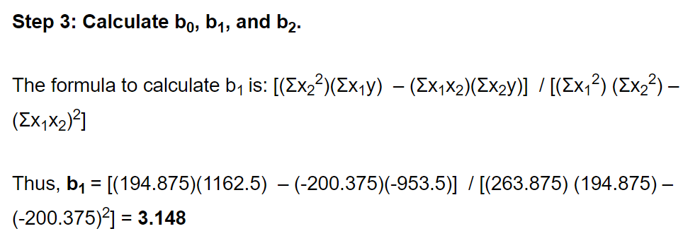
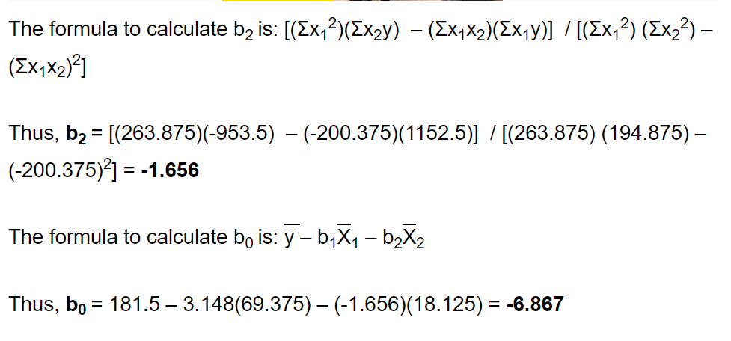
Multiple Linear Regression Numerical

Slide 22
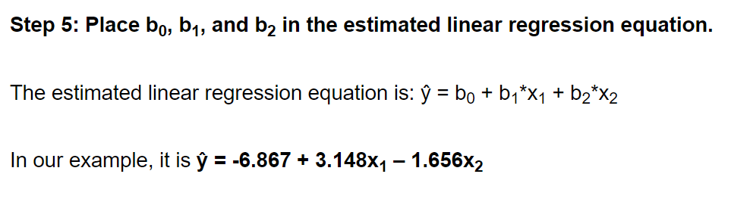
Multiple Linear Regression Numerical

Slide 23
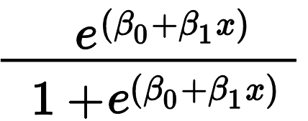
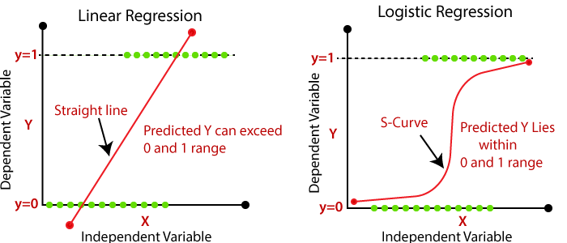
Logistic Regression
Logistic Regression is a “Supervised machine learning” algorithm that can be used to model the probability of a certain class or event. It is used when the data is linearly separable and the outcome is binary in nature.
That means Logistic regression is usually used for Binary classification problems.
Logistic Regression =
Binary Classification refers to predicting the output variable that is discrete in two classes. A few examples of Binary classification are Yes/No, Pass/Fail, Win/Lose, Cancerous/Non-cancerous, etc.

Slide 24
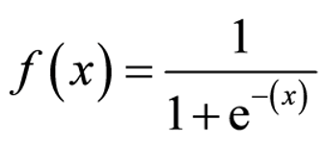
Logistic Regression
Logistic regression is one of the most popular Machine learning algorithm that comes under Supervised Learning techniques.
It can be used for Classification as well as for Regression problems, but mainly used for Classification problems.
Logistic regression is used to predict the categorical dependent variable with the help of independent variables.
The output of Logistic Regression problem can be only between the 0 and 1.
Logistic regression can be used where the probabilities between two classes is required. Such as whether it will rain today or not, either 0 or 1, true or false etc.
Logistic regression is based on the concept of Maximum Likelihood estimation. According to this estimation, the observed data should be most probable.
In logistic regression, we pass the weighted sum of inputs through an activation function that can map values in between 0 and 1. Such activation function is known as sigmoid function and the curve obtained is called as sigmoid curve or S-curve.

Slide 25
Difference between Linear Regression and Logistic Regression
Linear Regression | Logistic Regression
Linear regression is used to predict the continuous dependent variable using a given set of independent variables. | Logistic Regression is used to predict the categorical dependent variable using a given set of independent variables.
Linear Regression is used for solving Regression problem. | Logistic regression is used for solving Classification problems.
In Linear regression, we predict the value of continuous variables. | In logistic Regression, we predict the values of categorical variables.
In linear regression, we find the best fit line, by which we can easily predict the output. | In Logistic Regression, we find the S-curve by which we can classify the samples.
Least square estimation method is used for estimation of accuracy. | Maximum likelihood estimation method is used for estimation of accuracy.
The output for Linear Regression must be a continuous value, such as price, age, etc. | The output of Logistic Regression must be a Categorical value such as 0 or 1, Yes or No, etc.
In Linear regression, it is required that relationship between dependent variable and independent variable must be linear. | In Logistic regression, it is not required to have the linear relationship between the dependent and independent variable.
In linear regression, there may be collinearity between the independent variables. | In logistic regression, there should not be collinearity between the independent variable.

